Slide 1
Topic 2
Version Control System

Slide 2
At the end of this topic you will be able to
Create local git repository
Commit files in to this local repository
Create branch(s)
Working in different branch and merge together
Create remote repository
Synchronize local and remote repository
Create project plan on remote repository
Working as team leader or a member thorough VCS

Slide 3
VCS
Version control is a system that records changes to a file or set of files over time so that you can recall specific versions later. examples Git, CVS, SVN, Assemla, Mercurial, Bazaar
Types of VSC
Local Version Control Systems
Centralized Version Control Systems
Distributed Version Control Systems
Install Git https://git-scm.com/book/en/v2/Getting-Started-Installing-Git
Read more https://git-scm.com/book/en/v2/Getting-Started-About-Version-Control

Slide 4
Git
Git is an Open Source Distributed Version Control System. It is designed for
Speed
Simplicity
Fully Distributed
Excellent support for parallel development, support for hundreds of parallel branches.
Integrity

Slide 5
Git Commands
$git push
$git branch <branchname>
$git checkout
$git merge <branch>
$git remote add origin<URI>
$git pull
$git init
$git add <.> <file><*.extension>
$git commit –m”message”
$git status
$git log
$git config --global user.name” your name”
$git config –global user.email “gg@gmail.com”
https://git-scm.com/book/en/v2/Git-Basics-Getting-a-Git-Repository

Slide 6
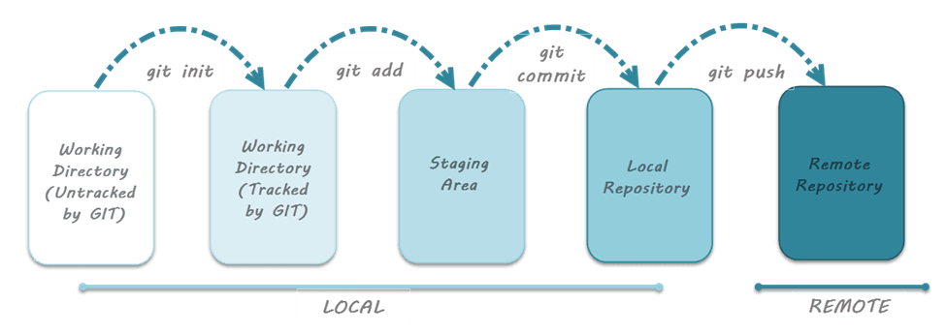
How git works?
4th
1st
2nd
3rd
5th

Slide 7
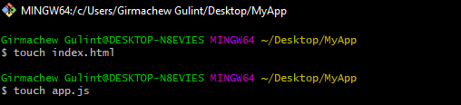
Create local folders and files
Git has Bash and GUI interfaces
In this session we will use Git Bash
To do this open Folder by Git Bash then it looks like this.
On Git bash we can create file like
touch index.html

Slide 8

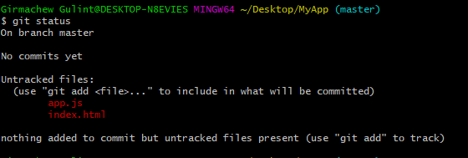
2. Initialize git and can check status
Untracked files
Initialize Git repository
No start Version control in Git

Slide 9
3. Add file to Git
Adding file to git has many option depend on file.
All file (git add .)
By extension git (git add *.extension)
Single file(git add index.php)

Slide 10
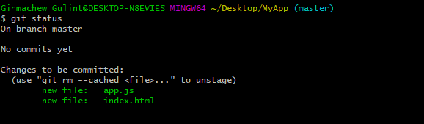
Add file again
All file (git add .)

Slide 11

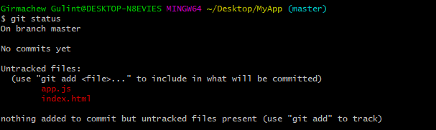
4. Git rm --cached file
If you don’t need this file in git you can remote it

Slide 12
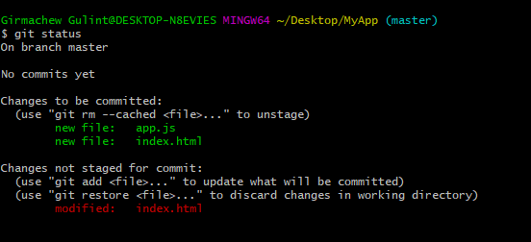
5. Modify index page content
Git can control content change of a file

Slide 13
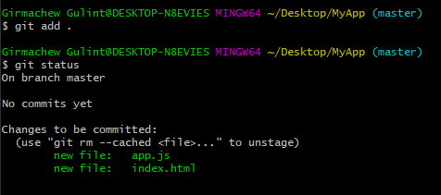
Add all files

Slide 14
6. Configure user’s name and email
If you are using git at the first time you have to configure :
$git config --global user.name” your name”
$git config –global user.email “gg@gmail.com”

Slide 15
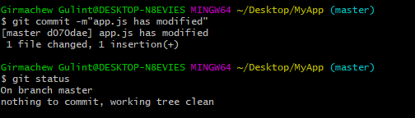
7. Commit file to Git
Now commit files in Git repository
Message is very important to identify commits.
If this file(s) is/are successfully saved in Git end of local repository git work.
Ready for remote collaboration.

Slide 16

8. Branching
In Git branching mean independent working areas.
Branch can be create by git branch <branch name>
To switch from one branch to another git checkout >branch name >

Slide 17
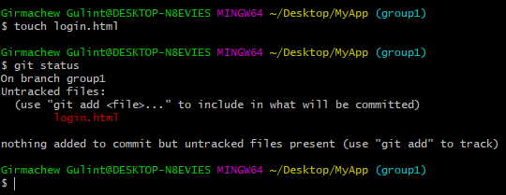
9. Add new file in group1 branch

Slide 18

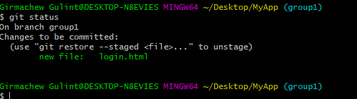

10. Add file to group1 branch
Add and commit in this new branch

Slide 19

11. Switch to master branch

Slide 20

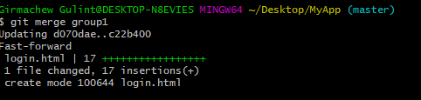
12. Git merge
When needed to merge (bring together) of branches to the root branch (master)
Git merge <child branch>

Slide 21
Sum-up Git
init➔add➔commit
If you want now you can push to remote repository.

Slide 22
What is GitHub?
It is web portal and cloud hosting service for your Git repositories.
It’s not mandatory to use Github.
The main secret of its success is the free plan with free unlimited public repositories.

Slide 23
How to use GitHub?
Create github account
Create remote repository (public or private)
Then you can push local repository to remote repository
You have projects management tool ,Wiki tool, Setting and more.

Slide 24



1. Add to Remote repository
$git remote can check remote repository
Add remote repository
Since remote repository is added
origin is shown

Slide 25

2. Git push

Slide 26
3. Add group members
To invite your group member to clone your remote repository
Go setting ➔mange account ➔invite ➔enter his/her email ➔invite

Slide 27
4. Group member now clone
When you invite your member he/she will get email notification
Then accept invitation and able to access the remote repository.
Copy the remote repository URL
Open git bash $git clone URL
Authenticate
Then do your task and push ($git add, $git commit, $git push)
The get other group members work ($git pull)

Slide 28
Git in vscode
These git commands are compatible in Vscode. So, you can use git commands in Vscode terminal.
Open new terminal and can code git commands

